Slide 1







Non Production Data Anonymisation
Handover Plan
V1.2
Internal
27 Aug 2019

Slide 2
Handover Update
100% of scope completed
Dev, NT, ST, OAT environments are anonymised
Anonymised 36 instances of database and decommissioned 4 instances
The anonymisation execution time for Talend jobs in OAT (7 environments) was within 22 hours. ~12 hours of Talend team effort was required overall towards job setup, execution, monitoring and validation.
All standalone environments anonymised (except CLASS – TechArch Scope)
Knowledge Retention
A Support member from Data Analytics team is provided with Knowledge (June- August)
3 Talend resources from Syntel were involved in the development. One person is released outside SLC and another one is released to Data Analytics Support Team. The last member in the team is allocated until end of October to support with any further handover needs/ warranty support.
Budget
Business case provision for ~63k per annum in run costs
Further Budget to cover from projects requesting refresh / change
Standard refresh requests are timetabled

Slide 3
Technical & Functional Artefacts
All Technical and Functional Artefacts are updated till date.
Further performance assurance check and review was done with Talend Consultant.
Technical / Functional Artefacts | Available | Reviewed By | Signed off
Technical Architecture | P:\Security Programme\11. FY1718 Projects\01. Data Anonymisation\01. P2P Deliverables\1.3 Delivery and Implementation\1.3.3 Detailed Design\CLASS Data Anonymisation Technical Approach | TDL, Project Team | Complete
Detailed Design (Mapping Document) | P:\Security Programme\11. FY1718 Projects\01. Data Anonymisation\01. P2P Deliverables\1.3 Delivery and Implementation\1.3.3 Detailed Design\Non Production Data Anon Field Mapping V1.6 | TDL, Project Team | Complete
Talend Job Level Details | P:\Security Programme\11. FY1718 Projects\01. Data Anonymisation\01. P2P Deliverables\1.3 Delivery and Implementation\1.3.3 Detailed Design\Non production data anonymisation ELT design approach v0.2 | TDL, Project Team | Complete
Run Books | P:\Security Programme\11. FY1718 Projects\01. Data Anonymisation\01. P2P Deliverables\1.3 Delivery and Implementation\1.3.8 Implementation Plan - Runbook\ | Project Team | Complete
Anonymisation Process | P:\Security Programme\11. FY1718 Projects\01. Data Anonymisation\01. P2P Deliverables\1.3 Delivery and Implementation\1.3.8 Implementation Plan - Runbook\Data anonymisation Operational Document v0.5 | Project Team | Complete
Setup Information per system | P:\Security Programme\11. FY1718 Projects\01. Data Anonymisation\01. P2P Deliverables\1.3 Delivery and Implementation\1.3.8 Implementation Plan - Runbook | Project Team | Complete
Deployment Details per system | P:\Security Programme\11. FY1718 Projects\01. Data Anonymisation\01. P2P Deliverables\1.3 Delivery and Implementation\1.3.8 Implementation Plan - Runbook | Project Team | Complete
Execution Steps per system | P:\Security Programme\11. FY1718 Projects\01. Data Anonymisation\01. P2P Deliverables\1.3 Delivery and Implementation\1.3.8 Implementation Plan - Runbook | Project Team | Complete

Slide 4
Operational Artefacts
Data Anonymisation is not a Production Service and is targeted for non production environments only.
All Development and Test environments are anonymised currently as part of the project and steps for future requests are documented.
Expected 2 systems (CLASS) for regular and 2 systems (SFD) for Adhoc refresh in a year.
Understanding of charge back to projects is under discussion by Environment Manager.
Operational Artefacts | Available | Reviewed By | Signed off
Data Refresh Requests – Process Flow | P:\Security Programme\11. FY1718 Projects\01. Data Anonymisation\01. P2P Deliverables\1.3 Delivery and Implementation\1.3.17 Process Flows\Data Anonymisation refresh request v0.3 | Project Team | Completed
Change Process Flow | P:\Security Programme\11. FY1718 Projects\01. Data Anonymisation\01. P2P Deliverables\1.3 Delivery and Implementation\1.3.17 Process Flows\Data Anonymisation change request v0.2 | Project Team | Completed
Standard Refresh - Process Flow | P:\Security Programme\11. FY1718 Projects\01. Data Anonymisation\01. P2P Deliverables\1.3 Delivery and Implementation\1.3.17 Process Flows\Data Anonymisation change request v0.2 | Project Team | Completed
Adhoc Refresh – Process Flow | P:\Security Programme\11. FY1718 Projects\01. Data Anonymisation\01. P2P Deliverables\1.3 Delivery and Implementation\1.3.17 Process Flows\Data Anonymisation change request v0.2 | Project Team | Completed
Integrated Environment Refresh - Flow | Runbook available for all 5 integrated environments | Project Team | Completed
Effort / Plan / Timelines for Requests | Presented | Under Review
SLA / Service Availability | Presented | Under Review

Slide 5
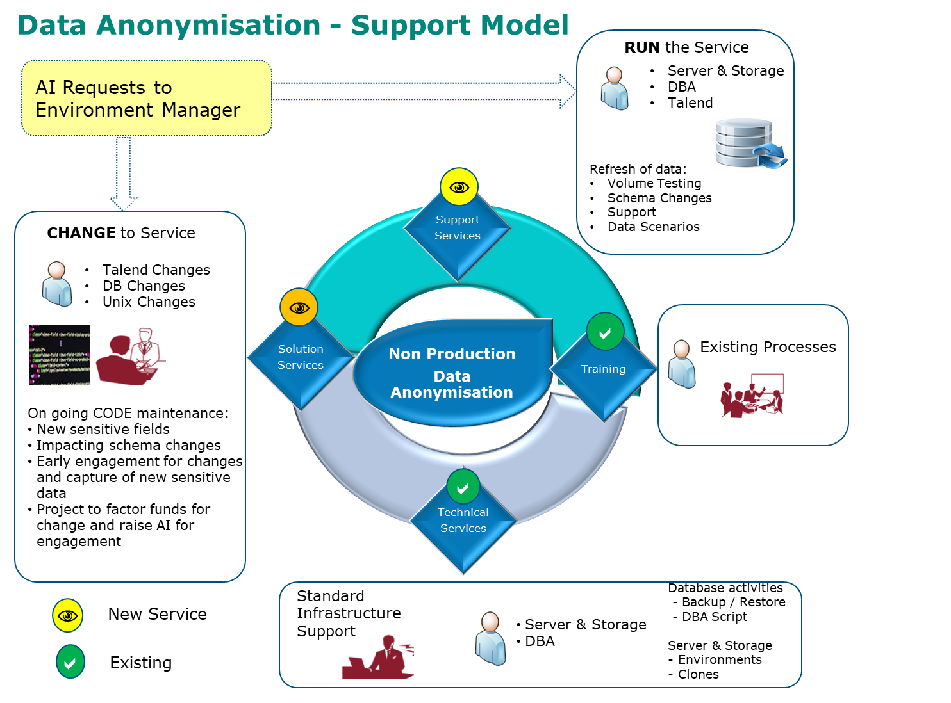
Support Model
Any existing DPIA waivers will be void for anonymised environments comprising systems like CLASS, SFD, ALL, FE, HE, CCT and Imaging.
Refresh of live data to standalone environments / integrated environments will not be permitted and “Anonymisation by default” is the design taken by the Board.
Any project requiring a refresh of anonymised data, should plan ahead to raise AI request with the Environment Manager.
Once a AI is requested, after subsequent planning the forecast for completion will be updated.
Refresh of data involves availability and effort from Environment Manager, Unix, DBA and Talend skilled members.
On an average 15 days of effort per request is required to be factored by the project to cover the efforts from above team.

Slide 6
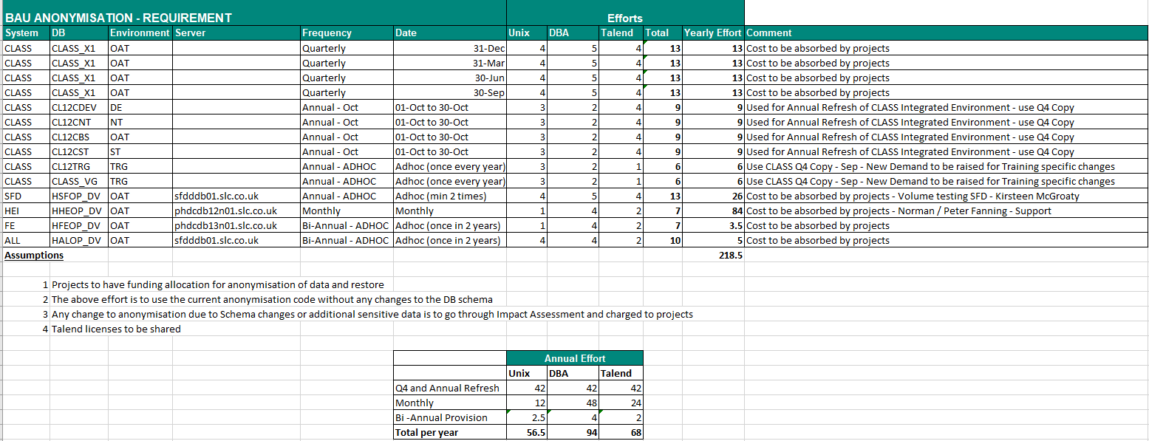
Effort / Plan/ Timelines
The actual effort to execute the jobs is only a fraction of the effort mentioned below as forecast is also based on calendar days of effort.
Effort below is caveated to resolve any unknown issues in future.
So far, the jobs are ran for over 20 times on full volume and been successful.
~14 days expected
vs
68 days forecasted

Slide 7
Plan – Annual Refresh (Regular Candidates)
Annual view of anonymisation is below for regular refresh (~ 10 days of Talend effort per Annum).
CLASS is expected to be refreshed regularly, while HEI is under confirmation for budget from Project.

Slide 8
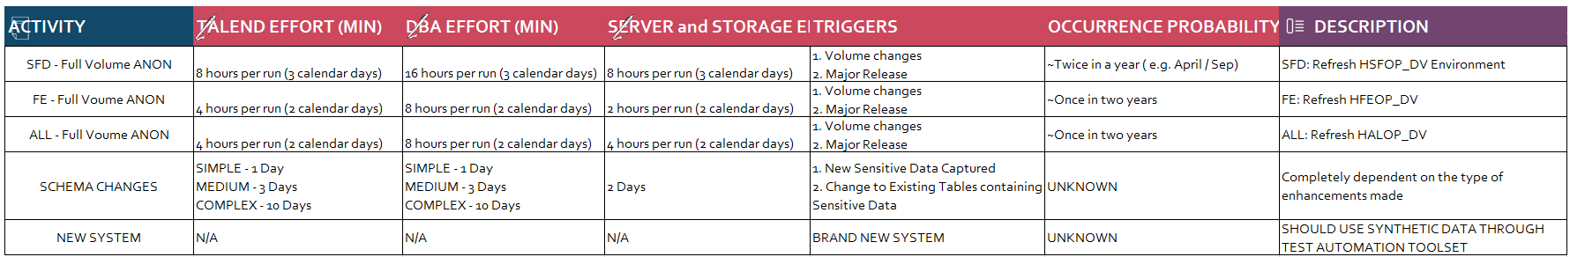
Plan – Annual Refresh (Adhoc)
Annual view of anonymisation is below for Adhoc Requests [~ 4 days of Talend Effort].
CLASS is expected to be refreshed regularly, while HEI is under confirmation for budget from Project.
GDPR Programme has taken the initiate under Privacy by Design to facilitate monitoring of changes to in-scope systems introducing new sensitive elements as part of the checklists.

Slide 9
Data Anonymisation - SLA
Under discussion by Environment Manager with all relevant stakeholders
This service is not a dedicated service. Business priorities may delay resource availability and adherence to the below suggested timelines.
ADHOC (16 to 20 DAYS)
Request Raised
Resource Allocated
Change Approved
2 Days to Respond
5 to 10 Days
2 Days
Data Prepared
1 Day
Pre Anon Completed by DBA
0.5 Day
Anon Completed
1 to 2 Days
Post Anon Completed
1 to 2 Days
Data Restored
1 Day
PLANNED (7 DAYS)
Pre Approved Change
Data Prepared
1 Day
Pre Anon Completed by DBA
0.5 Day
Anon Completed
1 to 2 Days
Post Anon Completed
1 to 2 Days
Data Restored
1 Day

Slide 10
Appendix
Design
Standalone Environments
Integrated Environments approach

Slide 11


Non Production Data anonymisation – Design
Strategic anonymisation Process
PROD Environment
Staging Area
(Within Production Control)
Landing Area
(DEVUAT)
NON-PROD Environments
Source Data
Anonymised Data
Source System
(development)
4
Source System
2
Transformation
Workspace
Anonymised Data
5
6
Operational Data
Release Control
Anonymised Data
3
Talend ELT /ETL
Anonymisation Solution
1
Operational data to be used in a non-production environment is sourced from an appropriate production data source.
Operational Data is copied (LUN Clone where appropriate) to the Staging Area (Except for HE & FE, where RMAN is copied to Landing). Any existing Encryption is retained.
Data is anonymised in-place using the Talend Anonymisation solution.
Release Control verifies the anonymisation process and releases the now anonymised data to the Landing Area and tears down the Transformation Workspace in the Staging Area.
Anonymised data is then copied to the non-production environment (Landing Zone and or Target) and instantiated. Data is decrypted in the Landing Zone.
Development and Test teams can then use the anonymised data.

Slide 12
Request to Anonymise Standalone Environment
Below are the Standalone Environments and details on the source, staging and landing for anonymisation
System | Source | Staging | Landing | Target
CLASS | LIVE(d2avdbcspe10.slc.internal) | D2AVDBANPE01 | D2AVDBANST01 | Standalone (e.g X1)
SFD | LIVE (sfdldb03) | D2AVDBANPE02 | D2AVDBANST02 | Standalone (e.g _DV)
ALL | LIVE (allldb01) | D2AVDBANPE02 | D2AVDBANST02 | Standalone (e.g _DV)
CCT | LIVE | D2AVDBANPE02 | D2AVDBANST02 | None exists
FE | LIVE (phdcdb13n01.slc.co.uk) | D2LVDBANST01* | D2LVDBANST01 | Standalone (e.g _DV)
HEI | LIVE (phdcdb12n01.slc.co.uk) | D2LVDBANST01* | D2LVDBANST01 | Standalone (e.g _DV)
* RHEL 4.2- No Staging Environment. Landing Environment is reused [Tactical until Portal Remediation]

Slide 13
Request to Refresh CLASS in Integrated Environment
Below are the consideration for future refresh of CLASS DB in the Integrated Environment
Sync ART_ID (Remains Same)
Sync SSN (First 4 Character unchanged)
Update Name, SSN in XXSL Schema and Other schema for respective CSR_ID from CLASS, where SSN’s Match for the first 4 characters
Sync CSR_SEQ (Reset to latest before rollout)
To avoid impact to Customer Portal
Sync CustomerIM CSR_SEQ with SFD, ALL, FE
Outbound / Inbound Correspondence
No Change

